Slide 1
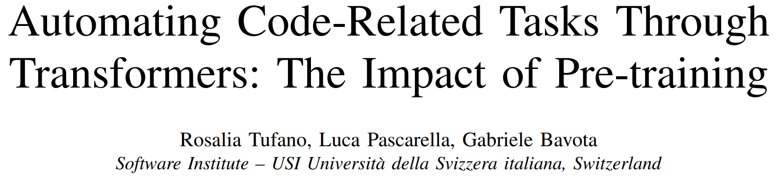
ICSE 2023

Slide 2
Abstract
Reality: Pre-training and fine-tuning is popular.
Problem: What is the impact of the specific pre-training objective(s)?
Our work:
Systematic literature review to identify pre-training objectives used in SE.
Pre-train 32 transformers using both
generic pre-training objectives usually adopted in SE;
pre-training objectives tailored to specific code-related tasks: bug-fixing, code summarization and code completion.
Compare pre-trained models with non pre-trained ones.
Our result:
Pre-training helps only if the amount of fine-tuning data available is small;
MLM objective is usually sufficient, even compared to specifically designed objectives.

Slide 3
Introduction
Transformers are usually trained in two steps: pre-train and fine-tune.
But little is known about
the circumstances in which pre-training actually helps, and
specific pre-training objective’s impact on SE performance.
What we know now (according to previous research):
When fine-tuning dataset is small, pre-training is helpful.

Slide 4
Introduction
Our study aims at
Investigating whether pre-training is useful in code-related tasks when large amount of data is available (e.g. code completion).
Experimenting the impact on transformers’ performance of both generic and task-specific pre-training objectives. Our tasks: bug-fixing, code summarization and code completion.

Slide 5
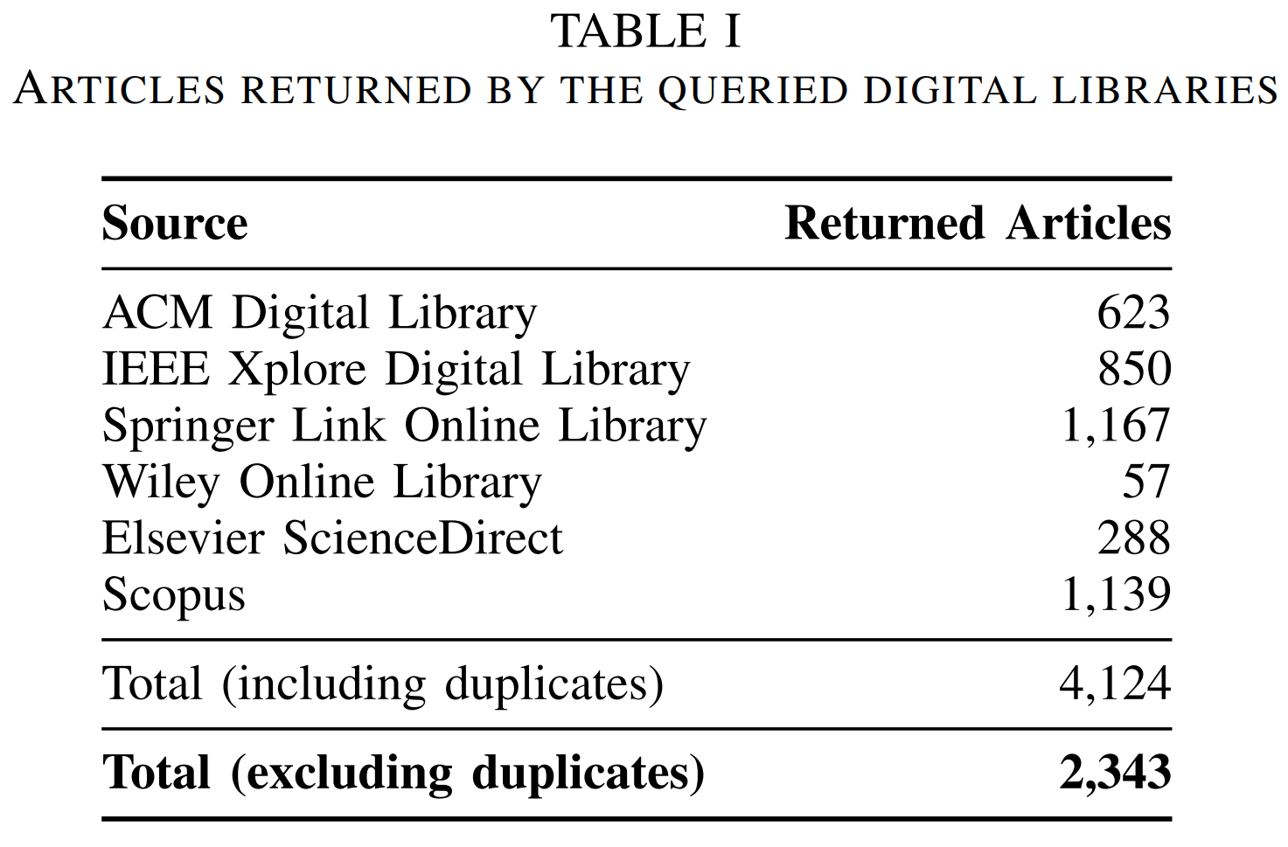
A Systematic Literature Review
Question: What are the pre-training objectives used in SE literature?
Published on international SE conference/journal
936
Filtered by one of the 3 authors (included when in doubts)
77
Double checked by one of the other 2 authors (not included when in doubts)
30
Add back papers of pre-training models if their models are used in SE papers for SE tasks
33

Slide 6
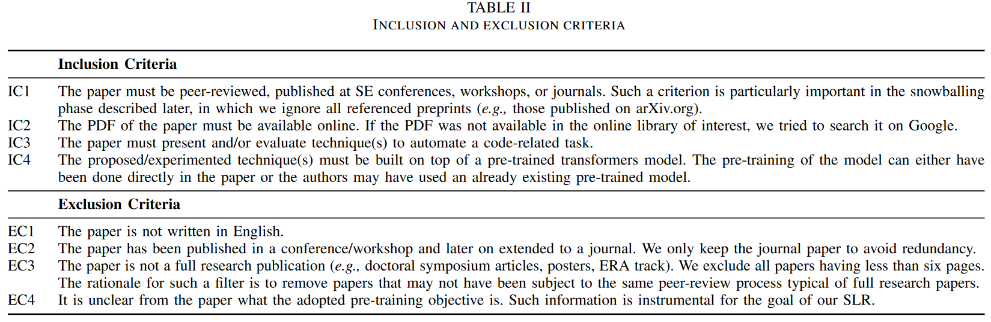
Inclusion and Exclusion Criteria

Slide 7
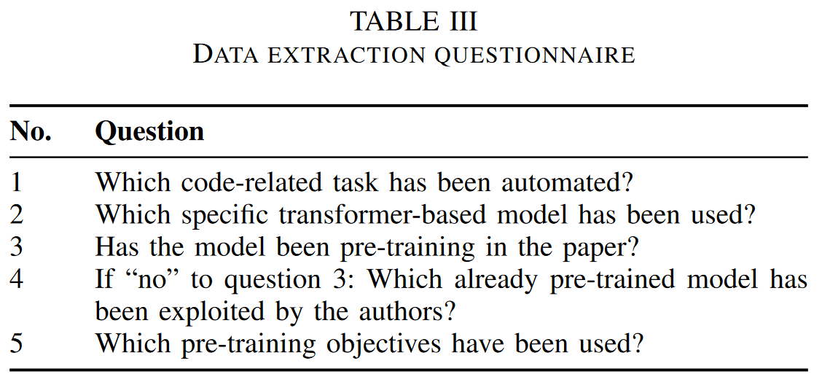
Data Extraction Questionnaire

Slide 8
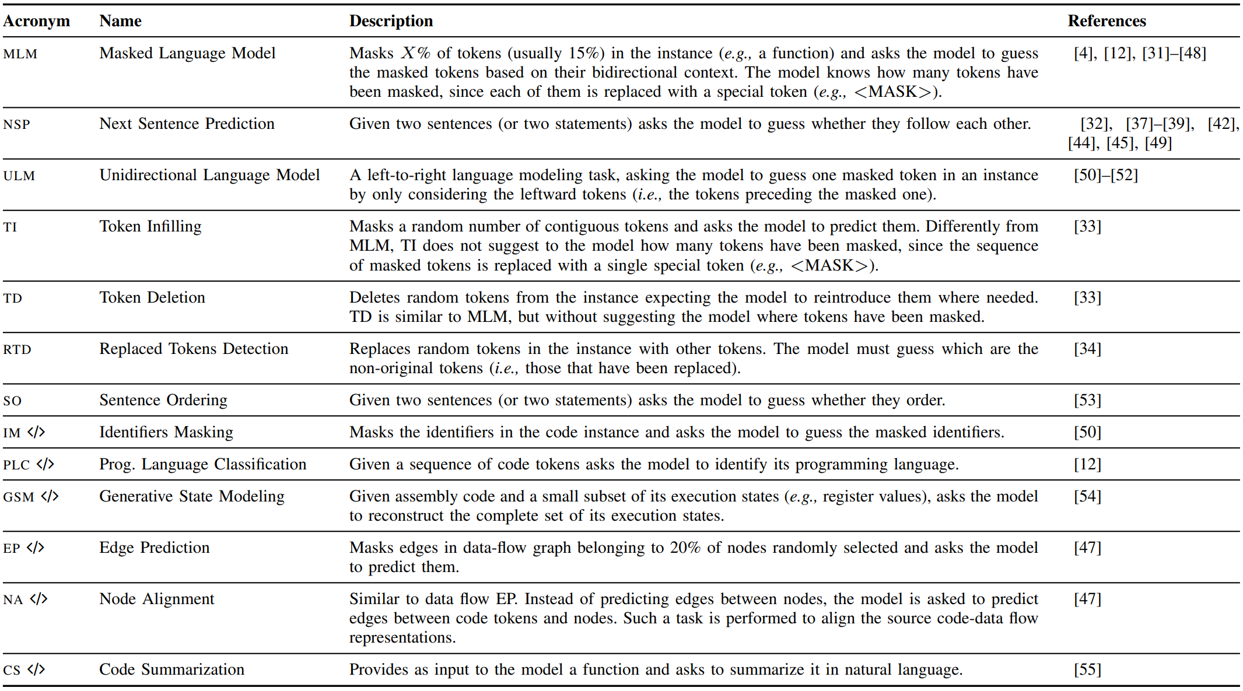
A Systematic Literature Review

Slide 9
Experiment Setup
RQs:
To what extent is the effectiveness of pre-training influenced by the size of the fine-tuning dataset?
Code summarization and code completion.
To what extent does the choice of the pre-training objective impact the performance of transformer models?
Code summarization, code completion and bug-fixing.

Slide 10
Experiment Setup
Architecture: T5 small (~60M, 6-layer encoder and decoder).
We have to train 36 models…
Our goal is not to achieve SOTA result, but to study the impact of pre-training.
Objectives:
RQ1: MLM (mostly used in literature).
RQ2: MLM, NSP and RTD (generic), and task-specific objectives:
Bug-fixing: injected-mutants fixing (self-made tool based on Javaparser).
Code summarization: method name generation.
Code (block) completion: code block selection.

Slide 11
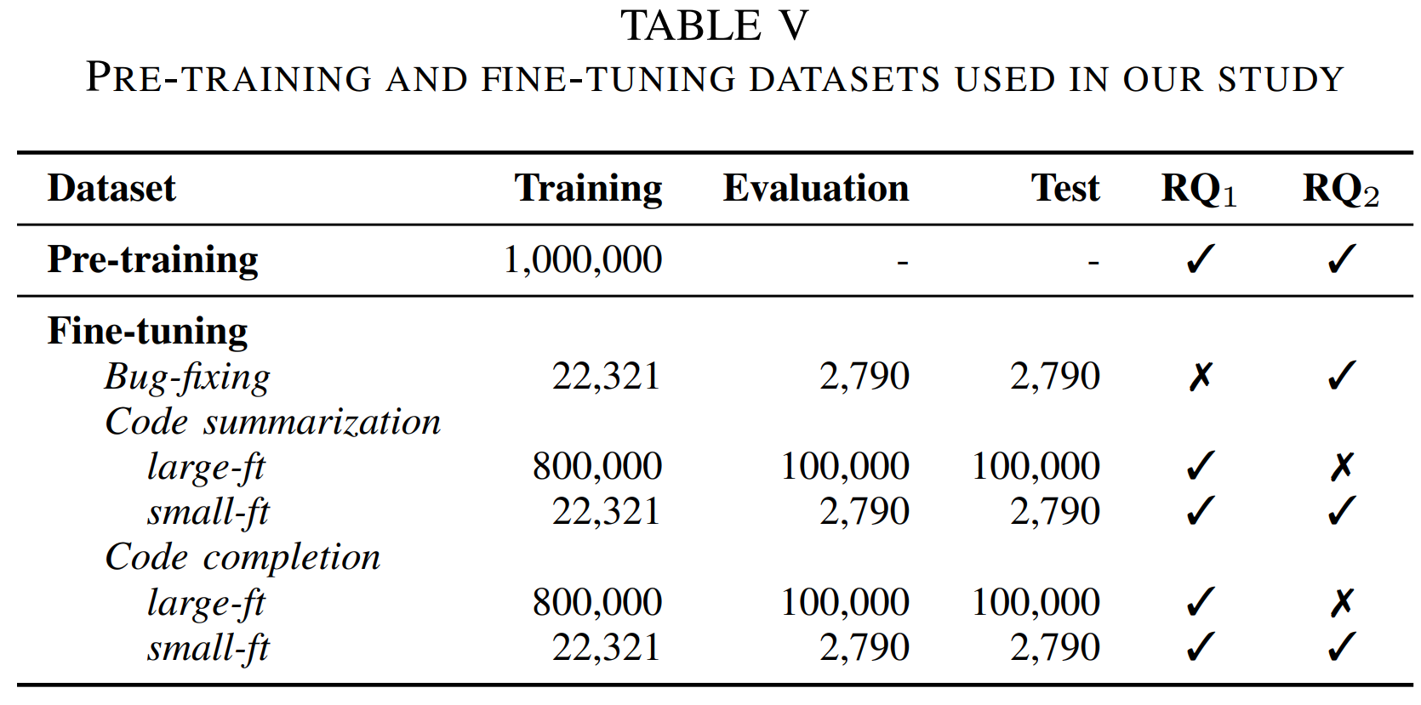
Experiment Setup

Slide 12
Experiment Setup
Pre-Training Dataset: a self-made Java dataset from GitHub.
Non-fork repos with ≥ 5 developers, 50 commits and 10 stars.
14,645 repos with 64,546,432 Java methods.
Exclude methods without Javadoc => 17,758,579 methods left.
Because code summarization need NL.
Because previous work suggest NL is beneficial for code-related pre-training.
Other cleaning (see the paper) => 4,821,922 methods left.
Exclude instances that are not suitable for our pre-training objectives.
219,863 methods removed because we cannot mutate them.
2,994,723 methods removed because they have no block to mask.
Format all code with Javaparser.
Randomly pick 1M methods as the pre-training dataset.
Because using all of them for pre-training is too expensive.

Slide 13
Experiment Setup
Fine-Tuning Dataset:
Bug-fixing: SequenceR’s one-line Java bug fixes dataset.
Remove class info and buggy line mark => align with pre-training.
Remove duplicated methods already present in pre-training dataset.
Format all code with Javaparser.
25,901 methods remained => train:valid:test = 8:1:1.

Slide 14
Experiment Setup
Fine-Tuning Dataset:
Code summarization: Funcom dataset.
Same preprocessing as pre-training dataset => align with pre-training.
Remove duplicated methods already present in pre-training dataset.
1M random methods as a large fine-tuning dataset (large-ft).
25,901 random methods as a small fine-tuning dataset (small-ft).
train:valid:test = 8:1:1.

Slide 15
Experiment Setup
Fine-Tuning Dataset:
Code (block) completion: CodeSearchNet Java.
Same preprocessing as pre-training dataset => align with pre-training.
Remove duplicated methods already present in pre-training dataset.
Mask each block separately => multiple versions of the same code.
1M random methods as a large fine-tuning dataset (large-ft).
25,901 random methods as a small fine-tuning dataset (small-ft).
train:valid:test = 8:1:1.

Slide 16
Experiment Setup
Procedure of RQ1:
Train on large-ft/small-ft, with/without pre-training (40 epochs).
Early stop by exact match on valid set (patience = 3 epochs).
Procedure of RQ2:
Compare 4 pre-training objectives (3 generic, 1 task-specific).
Add the best as a must-use objective, compare the other 3.
Repeat similar process until all objectives are added.
Metric is exact match on test set after fine-tuning.

Slide 17
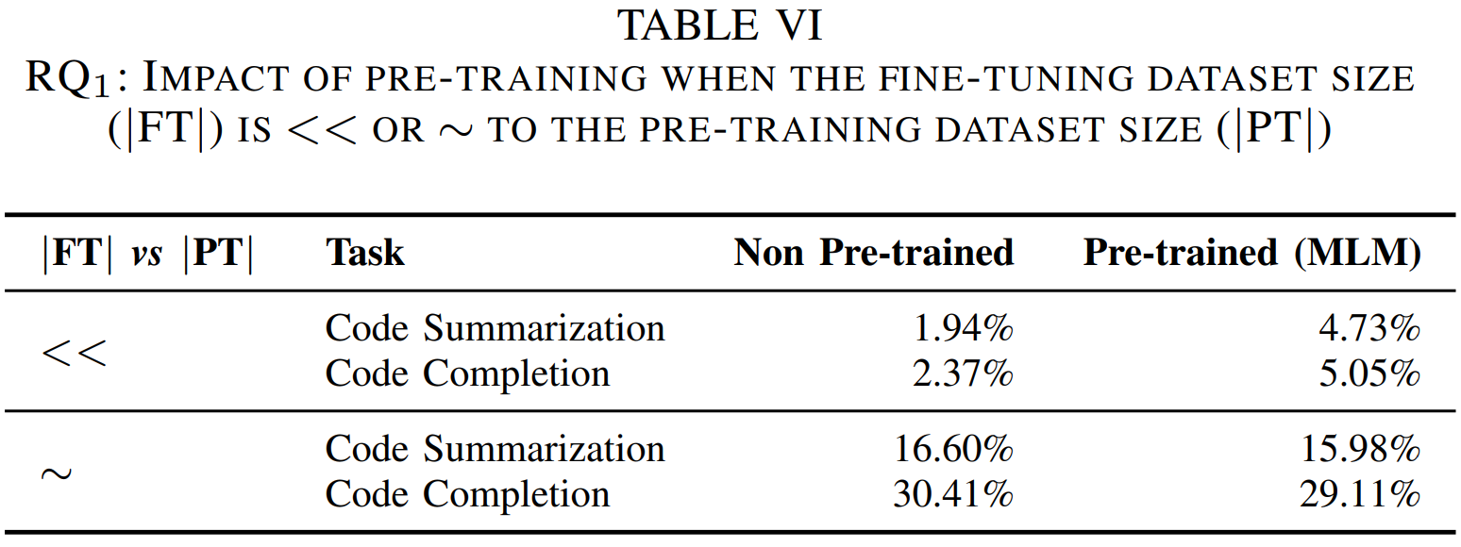
Experiment Results – RQ1

Slide 18
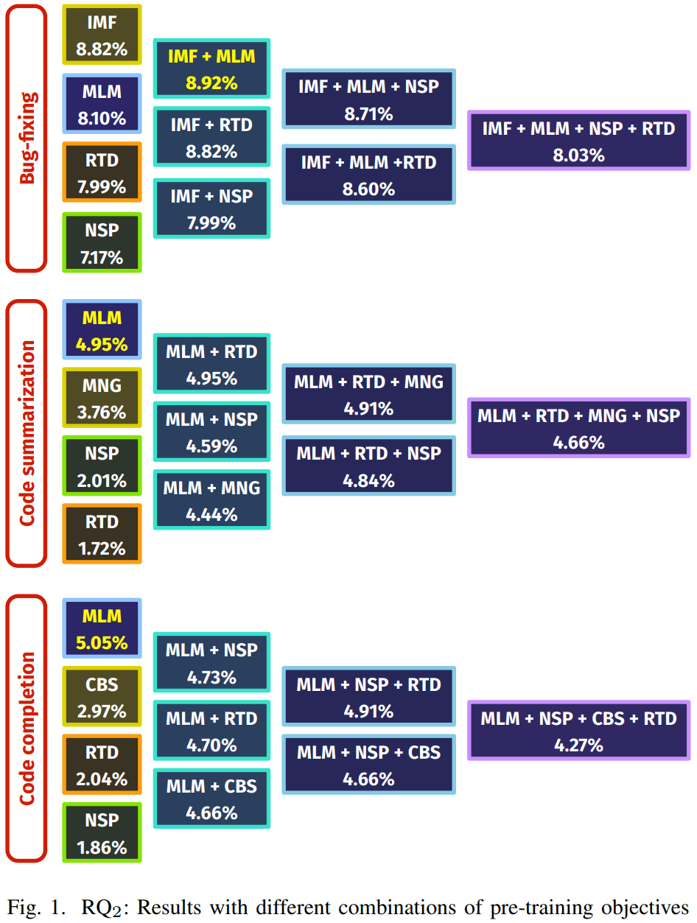
Experiment Results – RQ2
Different objectives do make difference in down-stream tasks.
MLM is highly effective.
Task-specific objective is effective if
Capture orthogonal info; and
Strictly simulate the down-stream task.

Slide 19
Threats to Validity
Using BLEU-4 for code summarization or edit distance for code completion does not change the conclusion.
Only papers published before 2022 are considered.
This work is not aimed to find all pre-training objectives.
Only T5 and Java methods are considered.
Performance on small-ft is substantially worse than that on large-ft. Maybe the size of small-ft is not realistic?
We just use the size of bug fixing dataset.
Real dataset is just so small.

Slide 20
Conclusion
Pre-training helps on small fine-tuning dataset.
Task-specific pre-training objectives do not result in a significant improvement compared to MLM.

